Slide 1
My American Dream Project
By: Carlo Ramos
6th period

Slide 2
My American Dream Project
By: Carlo Ramos
6th period

Slide 3
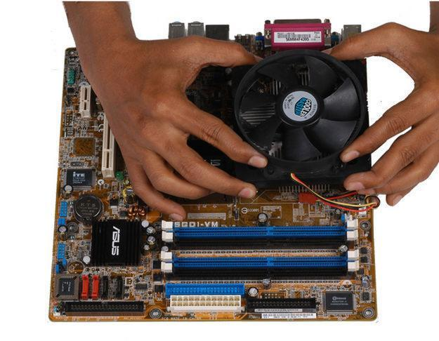
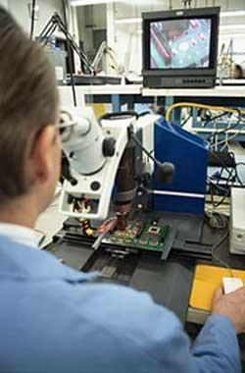
2 Professional Jobs
The two jobs that I'm interested in are...
Computer Hardware Engineering
Electronics Engineers, Except Computer

Slide 4
Computer Hardware Engineering
Average Salary: $98,810
Necessary Experience/Schooling: The most common degree is a Bachelor’s Degree and 4 - 6 years experience.
Why I chose that career:
like working with computers
have computer skills to create a website, fix, and retrieve datas.
Source: Computer Hardware Engineers - My Future. January 15, 2013. http://myfuture.com/careers/overview/computer-hardware-engineers_17-2061.00

Slide 5
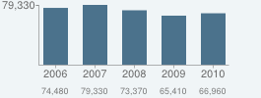
Computer Hardware Engineering: Projected Job Growth
Source: Computer Hardware Engineers - Job Growth - My Future. January 15, 2013.
http://www.myfuture.com/careers/growth/computer-hardware-engineers_17-2061.00

Slide 6
Electronics Engineers, Except Computer
Average Salary: $ 90,170
Necessary Experience/Schooling: 8 - 10 years experience and Bachelor's Degree
Why I chose that career:
a gift on fixing electronics
test them to see is it working properly.
Source: Electronics Engineers, Except Computer - My Future. January 15, 2013. http://myfuture.com/careers/overview/electronics-engineers-except-computer_17-2072.00

Slide 7
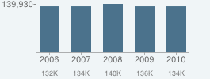
Electronics Engineers, Except Computer: Projected Job Growth
Source:
Electronics Engineers, Except Computer - Job Growth - My Future. January 15, 2013. http://myfuture.com/careers/growth/electronics-engineers-except-computer_17-2072.00

Slide 8
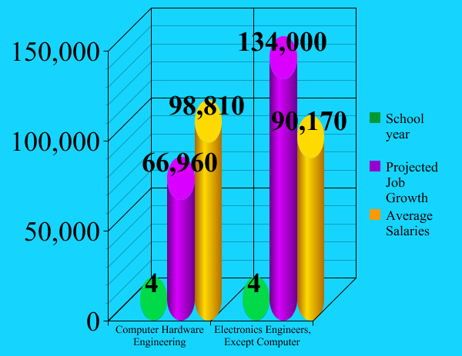
Source: Computer Hardware Engineers & Electronics Engineers, Except Computer. Found information January 15 2013 http://myfuture.com/careers/overview/computer-hardware-engineers_17-2061.00
http://myfuture.com/careers/overview/electronics-engineers-except-computer_17-2072.00

Slide 9
3 Colleges I wanted to go are...

Slide 10
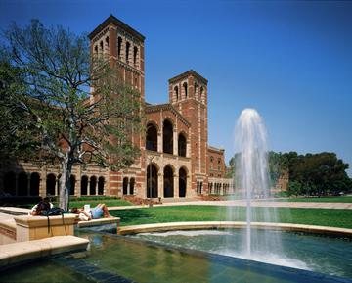
UCLA
Source: UCLA Human Genetics. January 17, 2013. http://www.genetics.ucla.edu/courses/statgene/

Slide 11
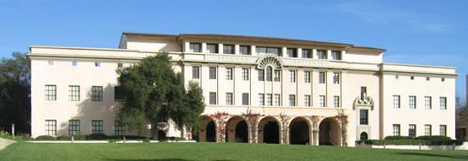
CALTECH
Source: About Caltech - Caltech Graduate Studies Office. January 18, 2013. http://www.gradoffice.caltech.edu/about

Slide 12
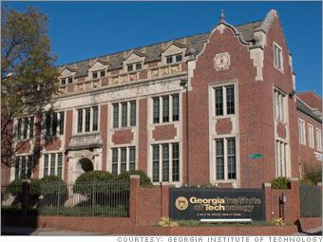
Georgia Tech University
Source: Georgia Institute of Technology MS, Quantitative ...- Best Masters USA. January 18, 2013 http://www.best-masters.us/ranking-master-financial-markets/georgia-institute-of-technology-ms-quantitative-and-computational-finance.html#.UQcPrx3LcxE

Slide 13
UCLA¹ | CALTECH² | GEORGIA TECH University³
Out-of-State: For two years $52,499 After Two years: $29,620 Graduated: $10,660 | In-State: $ 52,389 Graduated: $36,135 | In-State: $18,765 Graduated: $10,282
Urban Los Angeles, CA | Suburban Pasadena, CA | Urban Atlanta, GA
41,488 students | 2,244 students | 22,395 students
Source:
1: University California of Los Angeles. January 19, 2013. http://myfuture.com/schools/overview/university-of-california-los-angeles_110662
2: California Institute of Technology. January 20, 2013. http://myfuture.com/schools/overview/california-institute-of-technology_110404
3: Georgia Tech University. January 19, 2013. http://myfuture.com/schools/overview/georgia-institute-of-technology-main-campus_139755

Slide 14
UCLA¹ | CALTECH² | GEORGIA TECH University³
ACT Math: 25 ACT English:24 ACT Composite: 24 | ACT Math: 34 ACT English: 33 ACT Composite: 34 | ACT Math: 28 ACT English: 26 ACT Composite: 27
Robotics Club National Society of Collegiate Scholars | CALTech Engineering Club Anime Society | Honor Society Leadership Civil Engagement
Computer Science and Mathematics | Electrical and Electronics Engineering | Computer and Information Science, General
Source:
1: University California of Los Angeles. January 19, 2013. http://www.studentgroups.ucla.edu/home/
2: California Institute of Technology. January 20, 2013. http://www.career.caltech.edu/students/clubs
3: Georgia Tech University. January 19, 2013. http://deanofstudents.gatech.edu/studenthandbook/plugins/content/index.php?id=23

Slide 15
UCLA | CALTECH | GEORGIA TECH University
Most Popular choice in California | Class size More engineering options | Cost and distance
Cost | Cost | N/A
I like their basketball team | More engineering options | Cost and distance

Slide 16
Networking for a Job
Ask for help and give help
^{Use Facebook professionally}
Research Jobs that has great salary

Slide 17
Metacognition
Metacognition
Visit my counselor all time about colleges
Visit colleges website
Keep my GPA above or maintain 3.7-4.0
In state tuition fee is more expensive than out of state tuition fee

Slide 18
2 Professional Jobs
The two jobs that I'm interested in are...
Computer Hardware Engineering
Electronics Engineers, Except Computer

Slide 19
Computer Hardware Engineering
Average Salary: $98,810
Necessary Experience/Schooling: The most common degree is a Bachelor’s Degree and 4 - 6 years experience.
Why I chose that career:
like working with computers
have computer skills to create a website, fix, and retrieve datas.
Source: Computer Hardware Engineers - My Future. January 15, 2013. http://myfuture.com/careers/overview/computer-hardware-engineers_17-2061.00

Slide 20
Computer Hardware Engineering: Projected Job Growth
Source: Computer Hardware Engineers - Job Growth - My Future. January 15, 2013.
http://www.myfuture.com/careers/growth/computer-hardware-engineers_17-2061.00

Slide 21
Electronics Engineers, Except Computer
Average Salary: $ 90,170
Necessary Experience/Schooling: 8 - 10 years experience and Bachelor's Degree
Why I chose that career:
a gift on fixing electronics
test them to see is it working properly.
Source: Electronics Engineers, Except Computer - My Future. January 15, 2013. http://myfuture.com/careers/overview/electronics-engineers-except-computer_17-2072.00

Slide 22
Electronics Engineers, Except Computer: Projected Job Growth
Source:
Electronics Engineers, Except Computer - Job Growth - My Future. January 15, 2013. http://myfuture.com/careers/growth/electronics-engineers-except-computer_17-2072.00

Slide 23
Source: Computer Hardware Engineers & Electronics Engineers, Except Computer. Found information January 15 2013 http://myfuture.com/careers/overview/computer-hardware-engineers_17-2061.00
http://myfuture.com/careers/overview/electronics-engineers-except-computer_17-2072.00

Slide 24
3 Colleges I wanted to go are...

Slide 25
UCLA
Source: UCLA Human Genetics. January 17, 2013. http://www.genetics.ucla.edu/courses/statgene/

Slide 26
CALTECH
Source: About Caltech - Caltech Graduate Studies Office. January 18, 2013. http://www.gradoffice.caltech.edu/about

Slide 27
Georgia Tech University
Source: Georgia Institute of Technology MS, Quantitative ...- Best Masters USA. January 18, 2013 http://www.best-masters.us/ranking-master-financial-markets/georgia-institute-of-technology-ms-quantitative-and-computational-finance.html#.UQcPrx3LcxE

Slide 28
UCLA¹ | CALTECH² | GEORGIA TECH University³
Out-of-State: For two years $52,499 After Two years: $29,620 Graduated: $10,660 | In-State: $ 52,389 Graduated: $36,135 | In-State: $18,765 Graduated: $10,282
Urban Los Angeles, CA | Suburban Pasadena, CA | Urban Atlanta, GA
41,488 students | 2,244 students | 22,395 students
Source:
1: University California of Los Angeles. January 19, 2013. http://myfuture.com/schools/overview/university-of-california-los-angeles_110662
2: California Institute of Technology. January 20, 2013. http://myfuture.com/schools/overview/california-institute-of-technology_110404
3: Georgia Tech University. January 19, 2013. http://myfuture.com/schools/overview/georgia-institute-of-technology-main-campus_139755

Slide 29
UCLA¹ | CALTECH² | GEORGIA TECH University³
ACT Math: 25 ACT English:24 ACT Composite: 24 | ACT Math: 34 ACT English: 33 ACT Composite: 34 | ACT Math: 28 ACT English: 26 ACT Composite: 27
Robotics Club National Society of Collegiate Scholars | CALTech Engineering Club Anime Society | Honor Society Leadership Civil Engagement
Computer Science and Mathematics | Electrical and Electronics Engineering | Computer and Information Science, General
Source:
1: University California of Los Angeles. January 19, 2013. http://www.studentgroups.ucla.edu/home/
2: California Institute of Technology. January 20, 2013. http://www.career.caltech.edu/students/clubs
3: Georgia Tech University. January 19, 2013. http://deanofstudents.gatech.edu/studenthandbook/plugins/content/index.php?id=23

Slide 30
UCLA | CALTECH | GEORGIA TECH University
Most Popular choice in California | Class size More engineering options | Cost and distance
Cost | Cost | N/A
I like their basketball team | More engineering options | Cost and distance

Slide 31
Networking for a Job
Ask for help and give help
^{Use Facebook professionally}
Research Jobs that has great salary

Slide 32
Metacognition
Metacognition
Visit my counselor all time about colleges
Visit colleges website
Keep my GPA above or maintain 3.7-4.0
In state tuition fee is more expensive than out of state tuition fee

